Slide 1

GENDER EQUALITY INDICATORS

Slide 2

Context
In France, all companies with 50+ employees must publish a yearly index of gender equality.
Useful to have a proactive policy to develop gender equality – attract talent more easily.
2 steps required:
Creation of a CSV file for future analysis
A workflow created with KNIME with a graph for each indicator

Slide 3

GDPR
Creation of the CSV file - ensured that it complied with GDPR regulations.
Used the 5 principles of the data protection rules mentioned by CNIL
Updated the file by:
Changing DOB to age
Deleting first name, last name and phone numbers
Deleting marital status, number of children, and distance between home and work

Slide 4

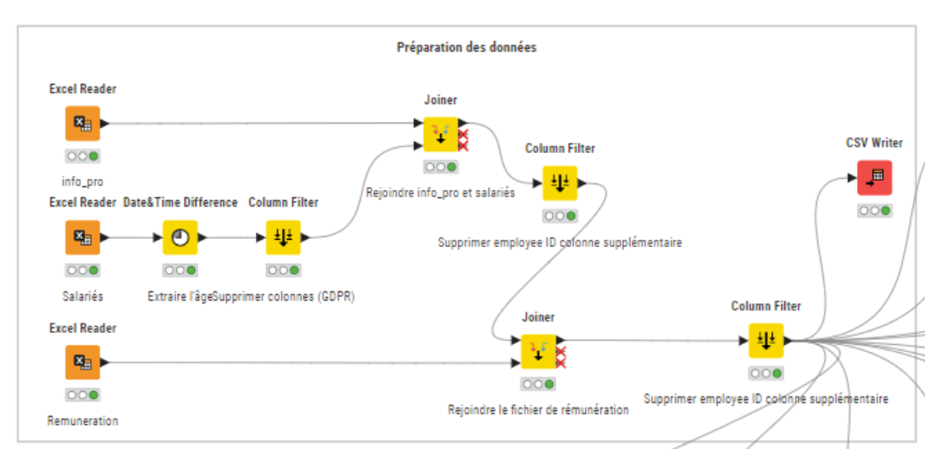
CSV File
13 columns
256 rows

Slide 5

Part 2 – KNIME workflow

Slide 6

Equality Indicators
Hiring
Promotion
Department
- Gender equity
- Average age
- Contract type
- Internal promotions
- Avg years at company
- Department
Safety and Security
Remuneration
- Work accidents
- Average monthly salary
Additional indicators :
- Pay rises
- Work satisfaction

Slide 7

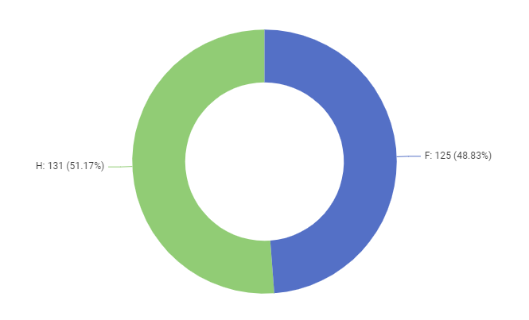
Hiring – Employees by gender
M

Slide 8

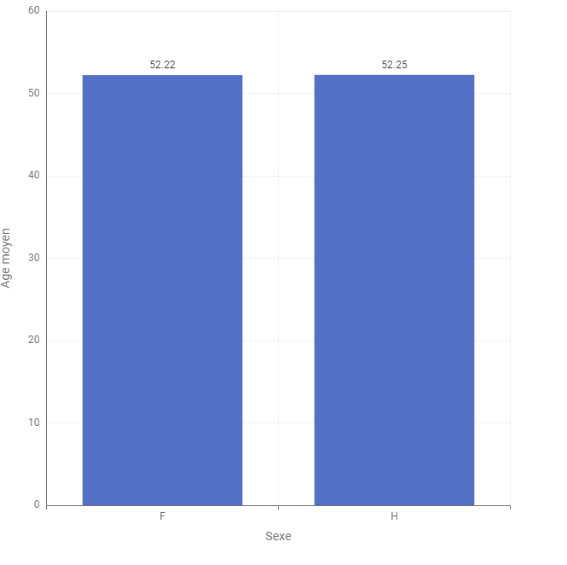
Hiring – Average age by gender
Average age
M
Gender

Slide 9

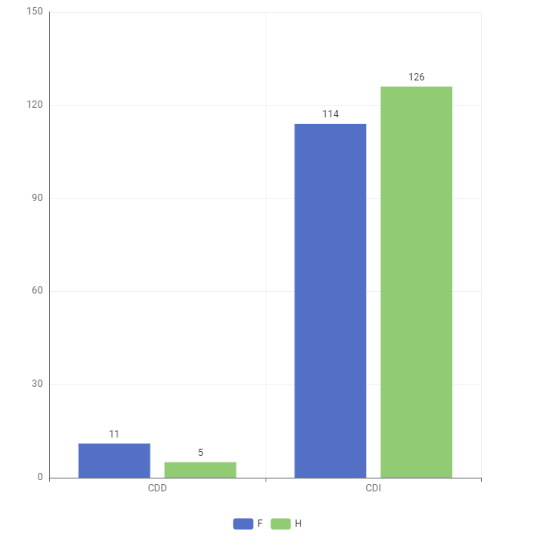
Hiring – Type of contract by gender
Average base monthly salary
Fixed-term | Permanent
2734 € | 5499 €
Fixed-term
Permanent
M

Slide 10

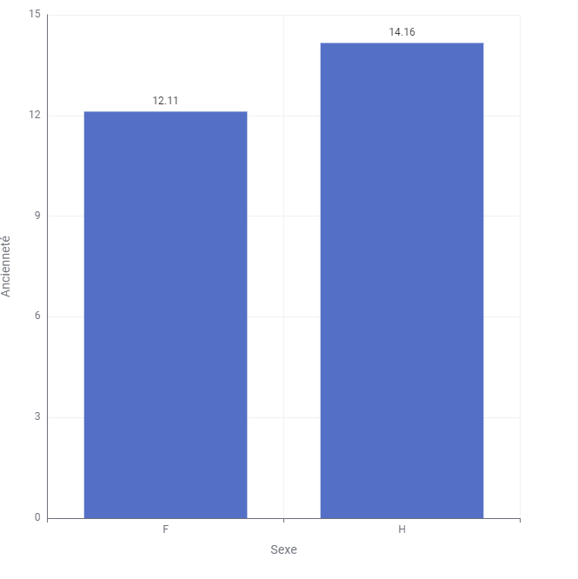
Average years working for company by gender
Years working
Gender
M

Slide 11

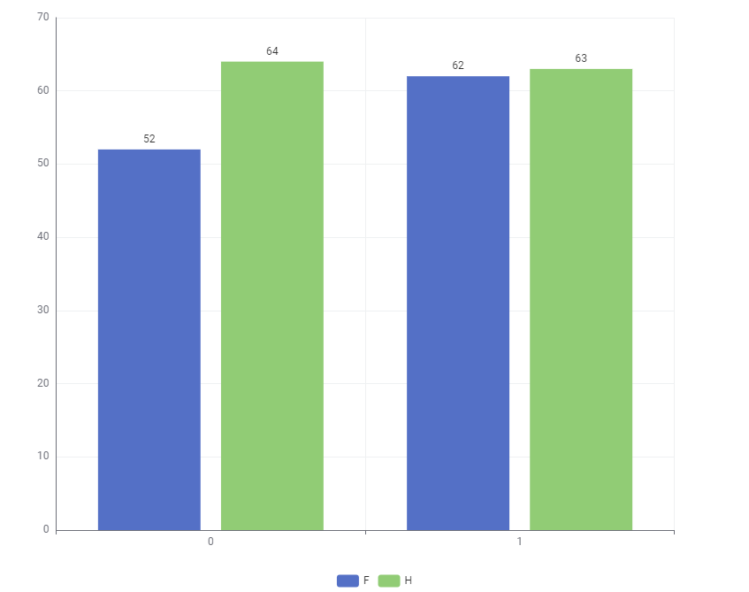
Promotions by gender
No promotion
Promotion
M

Slide 12

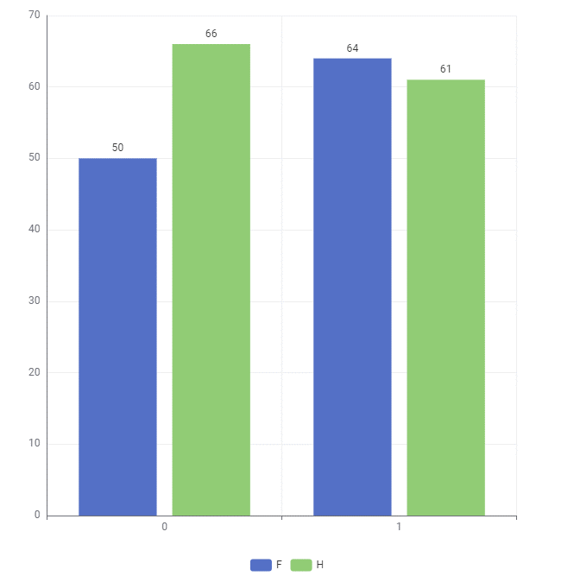
Pay rises by gender
No pay rise
Pay rise
M

Slide 13

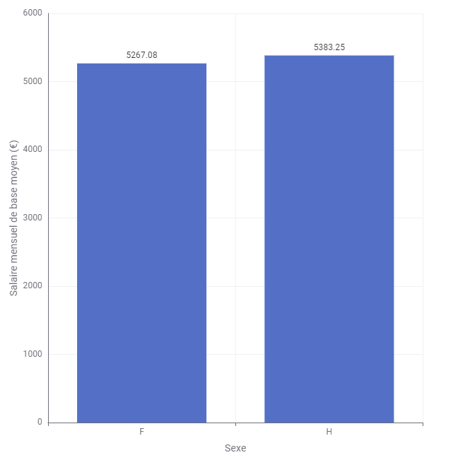
Average base monthly salary by gender
Average base monthly salary (€)
Gender
M

Slide 14

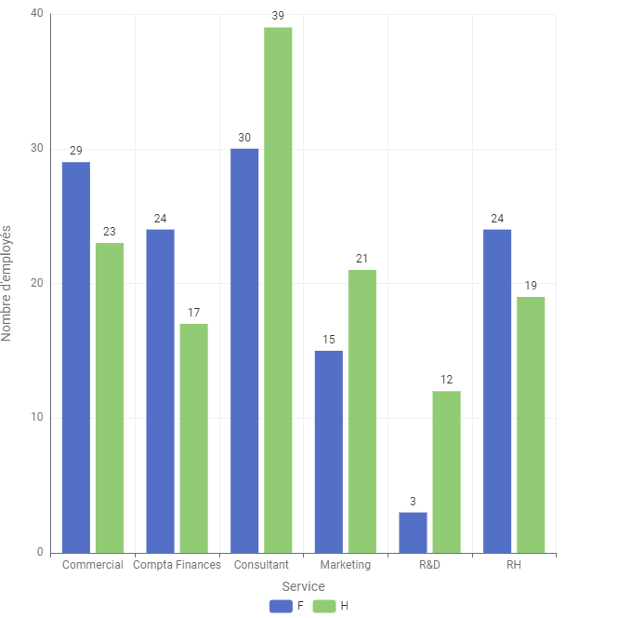
Employee gender by department
Number of employees
Department
M

Slide 15

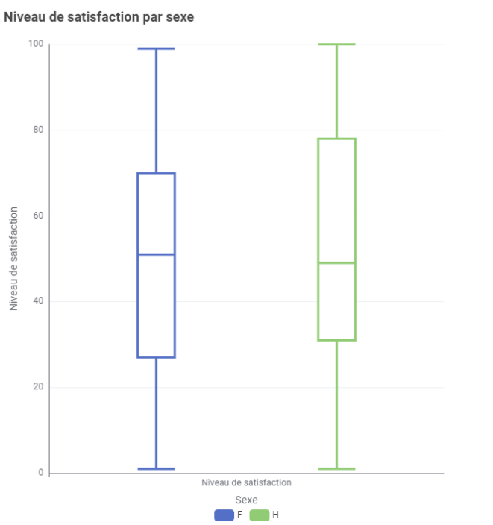
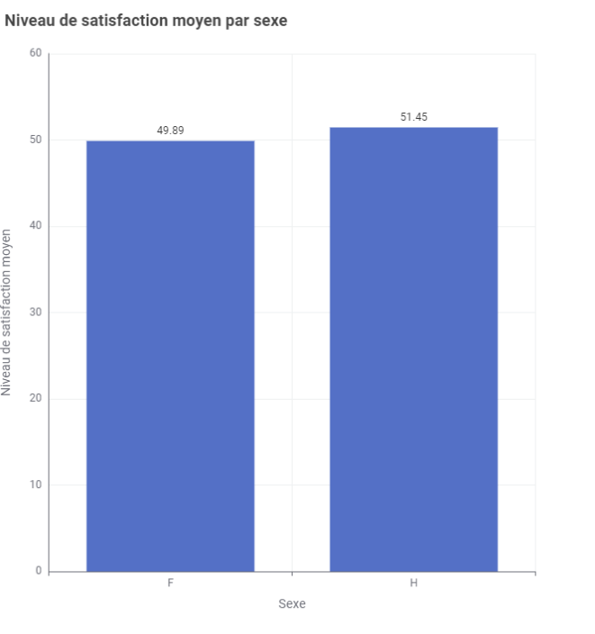
Satisfaction at work
Satisfaction at work by gender
Average satisfaction at work by gender
Level of satisfaction
Level of satisfaction
Average level of satisfaction
Gender
F
Gender
M
M

Slide 16

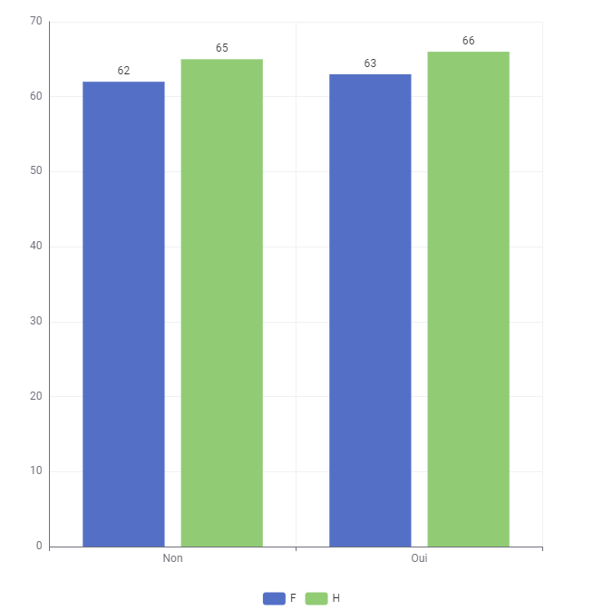
Experienced an accident at work
No
Yes
M

Slide 17
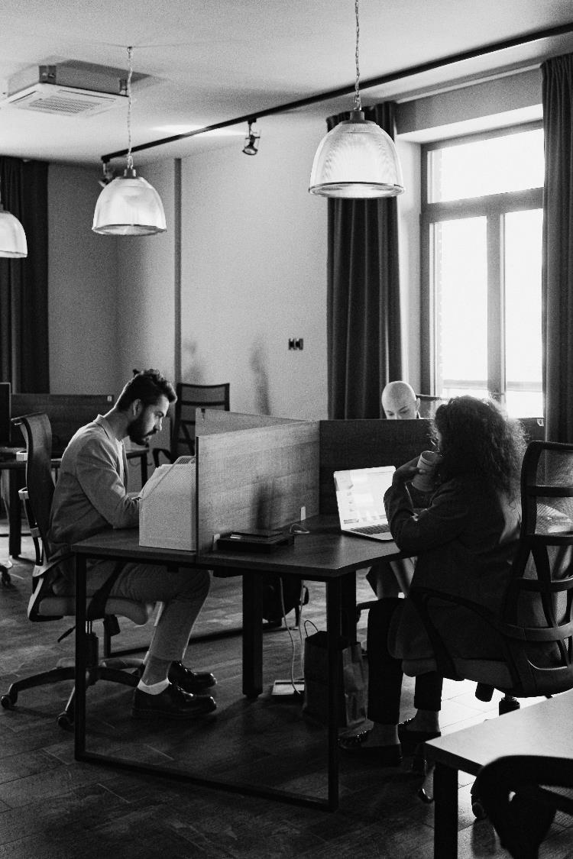





Conclusion
Many of indicators point towards equality
Gender distribution, age, job satisfaction and the number of workplace accidents all have similar figures for both sexes.
Women receive more pay rises and promotions
Despite this, women's salaries are lower than those of men. We need to investigate the reasons for the disparity in promotions and salary increases.
The R&D department have an unequal distribution of men and women
We should do further work to better understand the reasons for this difference, and to see what steps we should take to reduce the unequal distribution. .
Women are more likely to have fixed-term contracts than men
Fixed-term contracts offer less job security and these roles to have lower monthly salaries than permanent contracts. We should work to better understand the reason why women are more likely to have fixed-term contracts.
Men work more years for our company than women
Additionally, overall job satisfaction is relatively low. It would be useful to consider more flexible hours, teleworking and improved parental leave policies. This will benefit both sexes, while particularly encouraging women to continue working with us.

